Slide 1
Syntax and Decision Making
COMP2006 – Introduction to C++

Slide 2
Syntax and Decision Making
MTP:
1. Continuation of introduction to C/C++ including declarations, operators etc.
2. Loops and Decisions
3. Assignment Work

Slide 3
Directives
Recall that #include <iostream> is a preprocessor directive that tells the compiler to insert another file into your programming file
This is needed for the compiler to understand the C/C++ syntax
The newer standard C++ header files don’t have a file extension (ie. iostream) but the older header files from the “c” days do (ie. stdio.h is often used where h is for header) (you can always look these up)

Slide 4
Library Functions and Headers
There are many library functions available as you progress through C++. These include functions such as: File IO, mathematical computations, data conversions, etc.
For example to use the sqrt function you need to include the cmath library, the .lib file called by the compiler (or hardcode the function). Ex. #include <cmath>
The header files contain information for a particular group of functions. The functions themselves are grouped together in the library file but the information about them is located in the header
You can also say #include “iostream” which will first search the include directory but this is slower.. If the path is known you should use <>.

Slide 5
Variables
The types of variables were introduced last week
You must declare prior to use but this can be done anywhere in the program (unlike C where declarations must occur prior to the first executable statement)
It is good practise to include them at the beginning of your code though

Slide 6
Variables
Character constants are represented by ‘a’ rather than quotes
The C++ compiler translates this to the corresponding ASCII code and stores in 1 byte of memory
If you need to represent a character constant that isn’t on the keyboard you can use the ‘\xdd’ where dd is the hex digit and the \x is an escape sequence

Slide 7
Variables
The const qualifier specifies that the value of a variable will not change through the program. Any attempt to do so will result in an error. Ex. Const float PI = 3.14159F;
The #define directive can also be used although this is an old structure from C that isn’t popular to use today (you cannot set the data type used)
Ex. #define PI 3.14159 (use PI in the code)

Slide 8
Setw Manipulator
The setw manipulator causes the number (or string) that follows it in the stream to be printed within a field n characters wide, where n is the argument to setw(n).
It is useful for creating tables and lists with legible output
You must include <iomanip> to use this function (which is true for manipulators other than endl)

Slide 9
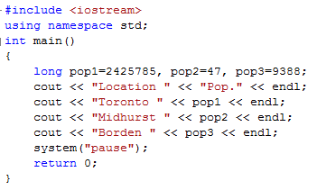

Setw Manipulator

Slide 10
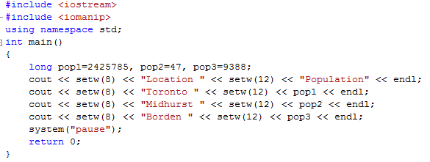

Setw Manipulator

Slide 11
Type Conversion
In C/C++ you can combine data types in arithmetic operations (unlike some languages where operations can only be completed on data of the same type)
When 2 operands of different types are encountered in the same expression, the lower-type variable is converted to the type of the higher-type variable
Ex. If intA * fltB is done ... A is converted into a flt to multiply with B, the final result is a flt
Generally this is fairly robust and done by the compiler in the background

Slide 12
Type Conversion (Automatic)
The automatic conversions can cause particular issues when statements use custom declared variable type (a later topic)
Data Type | Order
Long double | Highest
Double
Float
Long
Int
Short
char | Lowest

Slide 13
Casts
Type casts perform data conversion manually rather than through automatic actions taken by the compiler
Standard C++ allows for: static casts, dynamic casts, reinterpret casts, and const casts
An example the static cast below changes the variable of type int into a variable of type char
Ex. aCharVar = static_cast<char>(anIntVar);
New Var = static_cast<New Var Type>(Orig Var);
C casts are a little different but still work. Casts should only be used when needed and you will likely not use it often

Slide 14
Arithmetic Operators
The standard operators exist: +, -, /, *
The modulus operator (or remainder operator) (%) can be used with integer variables (types char, short, int, and long)
The modulus finds the remainder when 1 number is divided by another

Slide 15
Arithmetic Operators
C++ offers a condensed approach with the assignment operator . Ex. Total += item; //adds 2 copies of item together
Some of the arithmetic operations are: +=, -=, *=, /=, and %=
Increment Operators also exist, ie. the following are equivalent:
Count = count + 1;
Count += 1;
++count;

Slide 16
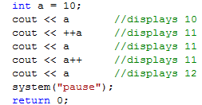
Arithmetic Operators
Increment operators can be used as either prefix or postfix operators.
Ie. totalWeight = avgWeight * ++count;
Count is incremented before the multiplication as it is a prefix notation
If it was count++, a postfix notation, the multiplication would have been performed first then count incremented
The decrement (--) exists and performs similarly to the increment operator including postfix and prefix

Slide 17
Debugging
Compilation errors are problems raised by the compiler, generally resulting from violations of the syntax rules or misuse of types. These are often caused by typos and the like.
Runtime errors are problems that you only spot when you run the program: you did specify a legal program, but it doesn’t do what you wanted it to. These are usually more tricky to catch, since the compiler won’t tell you about them
As we continue through the course we will discuss debugging (and you will get lots of practise!)

Slide 18
Basic IO
We will focus more on IO (file etc.) later but at this time we will review common methods of obtaining user input for our programs while displaying instructions to the user
We will explore:
printf() and scanf()
cout and cin
put and get

Slide 19
Basic IO – Printf and Scanf
Language: C
Library: cstdio or stdio
Syntax: standard function syntax using pattern string and variable-length argument list
Notes:
Often shorter text
Clearly separates arguments and actual type
It is a format string (easier to translate)
It is a const char * function
Cannot print NUL byte directly as it is a string
Displays: character, string, float, integer, octal and hexadecimal values to the screen

Slide 20
Basic IO – Printf and Scanf
Variable Use, ie. Printf is used with:
%d is used to display integer variable
%c is used to display character,
%f for float variable,
%s for string variable,
%lf for double
%x for hexadecimal variable.
To generate a newline, we use “\n”

Slide 21
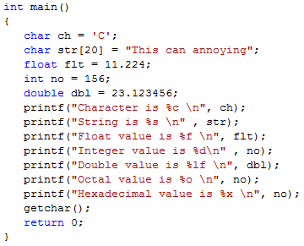
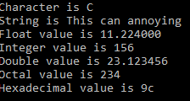
Basic IO – Printf and Scanf

Slide 22
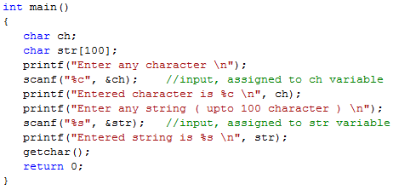
Basic IO – Printf and Scanf
scanf() function is used to read character, string, numeric data from keyboard
The same switches apply as with printf

Slide 23
Basic IO – cout and cin
Language: C++
Library: iostream
Requires the std namespace or std::cout
Syntax: Uses the << operator
Notes:
Easier handling of variable types (type safe)
Lower performance as each << is another call in ASM
The << and >> operators can be cascaded (ie. multiple in the sequence)

Slide 24
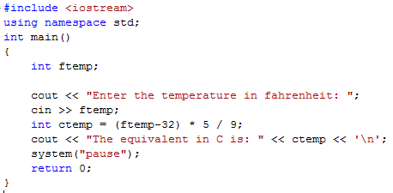

Basic IO – cout and cin
Cin is the standard input stream from the keyboard (unless redirected)
The >> is the extraction or get from operator (notice it is opposite than cout)
The << is the insertion or put to operator

Slide 25
Basic IO – cout and cin
Memory trick: if you have trouble remembering which way the angle brackets go for cout and cin, think of them as arrows pointing in the direction of data ﬂow.
cin represents the terminal, with data ﬂowing from it to your variables; cout likewise represents the terminal, and your data ﬂows to it.

Slide 26
Basic IO – get/put
Language: C++
Library: iostream.h
Notes:
Some compilers with printf string optimize the function to puts
Less commonly used and represents unformatted IO stream
There are other options available that we will look at later

Slide 27
Basic IO – get/put
get() :
The get() function is an input function.
It fetches a single character and store it in a character variable.
The get() is a member function of istream class and it is involved with an istream object cin.
Ex. char ch;
cin.get(ch); // get a char from keyboard, assign it to ch.
put() :
The function put() is an output function and is used to output a character at a time.
The put() function is also a member of ostream class and is involved with an ostream object cout.
Ex. cout.put('a');

Slide 28
Program and Text Controls
Depending on your platform the console window may close very quickly. Options:
Become very fast with a keyboard pause command
Use an IDE that displays the output without launching the console window
Use the command: system("pause"); (platform dependant)
End your code with: getchar(); (standard C++, will wait for you to enter text followed by enter)
Use an input IO functions prior to releasing the application

Slide 29
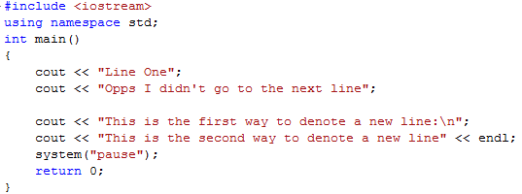
Program and Text Controls
For text output formatting you can use the \n escape sequence to create a new line or the endl manipulator
Exit(0) – Will terminate the programme wherever it is currently executing

Slide 30
2. Loops and Decisions
C/C++ has many options that you will be familiar with iterative processing or making non-linear decision making
The following will be explored:
Relational Operators
Loops
Decisions
Logical Operators
Precedence Summary
Other Control Statements

Slide 31
2. Loops and Decisions – Relational Operators
In C++ the relational operators, which can be used with any built-in or custom C++ data type, are:
The result of a relational decisions is either “True” (1) or “False” (0)
NB. It is very important to note that equal to is not =
Operator | Meaning
> | Greater than
< | Less than
== | Equal to
!= | No equal to
>= | Greater than or equal to
<= | Less than or equal to

Slide 32
2. Loops and Decisions – Relational Operators
Essentially the Relational Operator returns a 0 or a 1
While C++ does have the bool data type this was a modern enhancement. Historically C++ did not have a bool data type and only an integer value of 0 or 1 was available
Today, both True/False and 0/1 can be used however as we don’t often display relational operator based results this isn’t an issue for us. The operation is the same in either case.
NB. 1 represents true however C++ assumes every non-1 value is false. Thus incorrect logic, that say returns a 5 rather than 0, is interpreted the same way.

Slide 33
2. Loops and Decisions – Loops
A loop will be repeated a certain number of times, while the control condition is true
When the control condition becomes false the loop ends and the code resumes immediately following the loop
There are 3 looping mechanisms in C++: for loop, while loop, and do loop

Slide 34
2. Loops and Decisions – Loops – For
The for loop is often the easiest to understand based on syntax location
The loop is repeated a fixed number of times. There are 2 constructs available:
Ex. For (j = 0; j < 15; j++) (no semicolon)
statement; (single-statement body)
Main code continues
You can use {} with the single statement to improve clarity if you wish.

Slide 35
2. Loops and Decisions – Loops – For
Ex. For (j = 0; j < 15; j++) (no semicolon)
{
statement; (multiple-statement body)
statement;
} (no semicolon)
Main code continues
The general form:
For (initialisation expression, test expression, increment expression)

Slide 36
2. Loops and Decisions – Loops – For
If you define variables inside the block code inside the for loop this will not be accessible outside the block elsewhere in your project
One advantage of restricting the visibility of variables is that the same variable name can be used within different blocks in the same program
This defining of variables inside a block is common in C++ but not common in C.
Use indenting to make your loop visible. Be consistent but your selected style is a personal call

Slide 37
2. Loops and Decisions – Loops – For
Variations are possible:
You can decrement in the for loop
For (int j = 5; j > 0; j--)
You can declare the variable (as done above) in the loop. This is often done in C__ to keep it close to the point of use, it is only available in the loop (in standard C++, MS C++ defines it for the rest of the file but this is not standard)
You can have multiple values in the for expression (comma to separate) Ie. for (j = 0, i = 3; j>22; j++, i--)

Slide 38
2. Loops and Decisions – Loops – While
A while loop will be repeated until the loop is terminated through a test expression. There is no initilization or increment components.
Ex. While (n != 5) (no semicolon)
cin << n; (single-statement body)
Main code continues
The loop variable must be initialised before the loop begins. There must also be an exit path.

Slide 39
2. Loops and Decisions – Loops – While
Ex. While (v2 < 15) (no semicolon)
{
statement; (multiple-statement body)
statement;
} (no semicolon)
Main code continues
The general form:
For (validation to continue)

Slide 40
2. Loops and Decisions – Loops – While
Precedence: Arithmetic and Relational Operators
The while loop can contain a test expression such as: (next < limit / 2)
Arithmetic operators have a higher precedence than relational operators. Thus the limit/2 will be evaluated first before comparison. You could also use: (next < (limit/2)) but they are the same in this case.

Slide 41
2. Loops and Decisions – Loops – Do
The do loop will ensure the loop is executed at least once regardless of controls in place
Text expression occurs at the end of the do loop
Ex. Do (no semicolon)
Statement; (single-statement body)
While (EndThis != “Y”) (no semicolon)
Main code continues

Slide 42
2. Loops and Decisions – Loops – Do
Ex. Do (no semicolon)
{
statement; (multiple-statement body)
statement;
}
While (Counter < 11); (semicolon)
Main code continues
Application Note:
For Loop – ideal when number of iterations known
While and do loops ideal when unknown number of iterations required
While loop can be used to ignore function and do loop will execute at least once

Slide 43
2. Loops and Decisions – Decisions - If
Simplest of the decision statements, can be nested
Ex. If (x > 6) (test expression)
Statement; (single statement)
Main Body Continues
Ex. If (x > 22) (test expression)
{
statement; (multiple-statement body)
statement;
} (no semicolon)
Main code continues

Slide 44
2. Loops and Decisions – Decisions – If ... Else
Allows you to take action if something is true or not. These can also be nested but ensure the if/else structures match up! (ie. else if cascading)
If (x > 5)
Statement; (single-statement if body)
else
Statement; (single-statement else body)

Slide 45
2. Loops and Decisions – Decisions – If ... Else
If (x > 22) (test expression)
{
statement; (multiple-statement body)
statement;
} (no semicolon)
else
{
statement; (multiple-statement body)
statement;
} (no semicolon)
Main code continues

Slide 46
2. Loops and Decisions – Decisions – Switch
Possible use when confronted with a large decision tree and you don’t want to have a significant number of else/if statements
Assign the value to the switch variable before the structure starts
Break causes the switch statement to exit. You will generally want this rather than proceeding to the next case statement.
If no case is matched it will go to default keyword. Suggested to include this for error control.
Switch may clarify code but can only be used for 1 comparison

Slide 47
2. Loops and Decisions – Decisions – Switch
Switch (n) (no semi-colon)
{
case 1: (1 is an integer or char constant, not floats etc)
statement;
break;
case 2:
statements;
break;
case 3:
statement;
break;
default: (default body)
statements;
} (no semi-colon)

Slide 48
2. Loops and Decisions – Decisions – Conditional Operator
If (A < B)
min = A;
else
min = B;
This structure is very common. C/C++ compresses it using a conditional operator.
This can be: // (A<B) is conditional op. (test)
min = (A<B) ? A : B; // A and B is conditional expression
// the ? And : form the conditional operator

Slide 49
2. Loops and Decisions – Decisions – Conditional Operator
Example:
absvalue = n<= ? –n : n;
If n is less than 0, the expression becomes –n (positive number). If n is not less than 0 the expression remains n.

Slide 50
Logical Operators
Arithmetic operators: +, -, *, /, %
Relational operators: >, <, >=, <=, ==, !=
Logical (boolean) operators:
NB. There is no native XOR function
Operator | Effect
&& | AND
|| | OR
! | NOT

Slide 51
Logical Operators
Ex. If (x<5 || x>15) (note lack of brackets)
Ex. !(x==7) is the same as x!=7
Ex. (x%7==0) will result in x being 0 if it is a multiple of 7 (without checking every numerical combination)

Slide 52
Precedence Summary
If in doubt use brackets (BEDMAS) to ensure operation is clear to both compiler and readers
Operator Type | Operators | Precedence
Unary | !, ++, --, +, - | Highest
Arithmetic | Multiplicative:*, /, %
 | Additive: +, -
Relational | Inequality: <, >, >=, <=
 | Equality: ==, !=
Logical | And: &&
 | Or: ||
Conditional | ?:
Assignment | =, +=, -=, *=, /=, %= | Lowest

Slide 53
Other Control Statements
Break; – exits from a loop (not the program), the next line executed is after the loop in which break is located. NB. If it is a nestled loop the break will bring you up to the nest looped level.
Continue; – returns to the top of the loop to the closing brace of the loop body from which you return to the top of the loop (ie. when something unexpected happens)
Goto YourLabel; - the code will jump, not suggested Code Code Code
YourLabel: //control will start after this following the goto

Slide 54
Summary
Relational operators compare two values to determine equality. The results are either False (0) or True (1 or any other non-zero number)
3 looping options exist: for, while, do
The loop body can be a single statement or a block of code delaminated by braces. Variables defined within the block are only internally visible
4 decision-making options exist: if, if-else, else-if, and the switch

Slide 55
Summary
The AND, OR, and NOT operators can be used for Boolean expressions.
break statement - sends control to the end of the innermost loop or switch in which it occurs.
continue statement - sends control to the top of the loop in which it occurs
Goto statement – sends control to a label
Precedence specifies which kinds of operations will be carried out first. The order is: unary, arithmetic, relational, logical, conditional, assignment

